Slide 1




Basketball II
Produced by Dr. Mario
UNC STOR 390

Slide 2
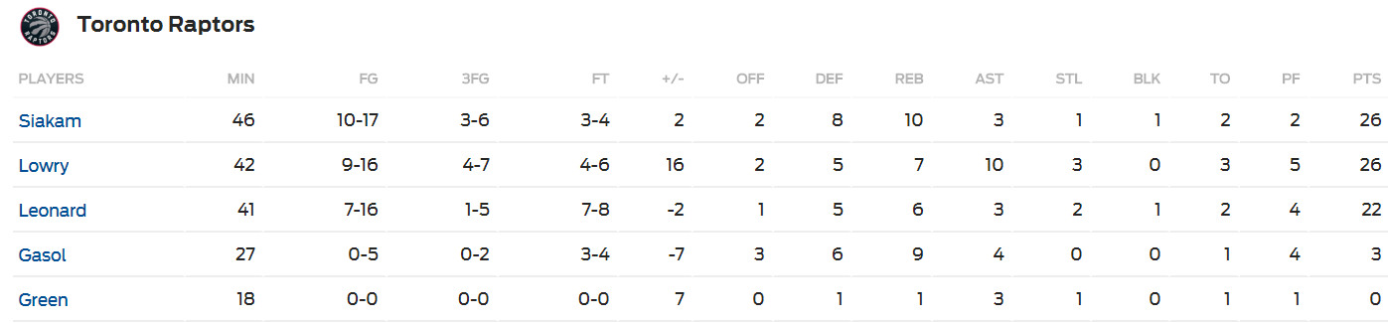
+/- Player Ratings
Recall the Box Score
Traditional Statistics Do Not Measure Player’s Ability to … “Make the Team Better”
Notice the Additional Metric

Slide 3
+/- Player Ratings
Pure +/- Ratings
Historically from Hockey
Number of Goals a Player’s Team Outscores Opponent When a Specific Player is Playing on Ice
Highest: Bobby Orr, 1970-1971, +124
“Worst Statistic in Hockey” by Hockey-Graphs.com
Counting Statistic of Rare Event (Subject to Outliers)
Time on Ice Not Reflected
Players Who Play the Most and Least Have +/- Closer to 0
Weakest Players Not Given Time to Accumulate Negative +/-
Same Values are Not Equal i.e. +5 Can Result from Many Scenarios
Application to Basketball
Pure +/- Statistic Based on Points and Scaled to 48 Minutes
Depends on Quality of Players When Player is on Court
Players on Bad Teams (Below .500 Record) Get Penalized

Slide 4
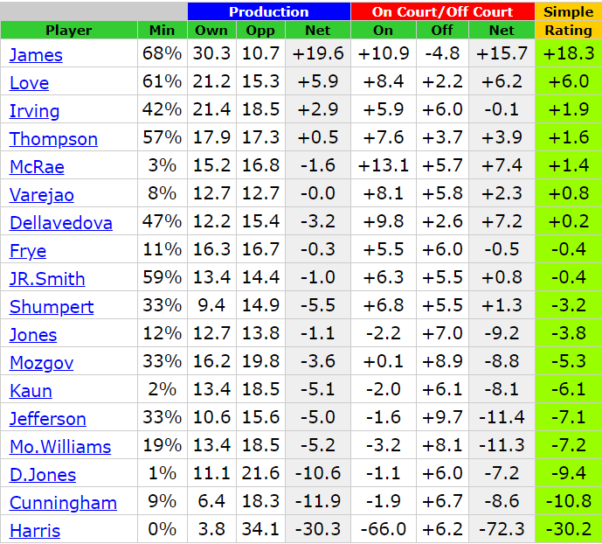
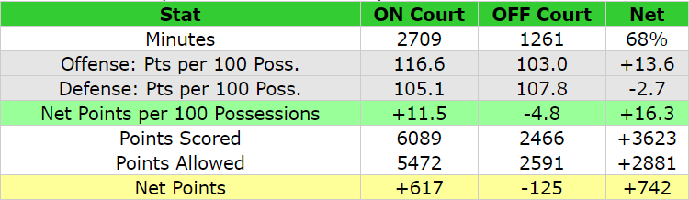


+/- Player Ratings
Pure +/- Ratings
Found on www.82games.com
Cavs Championship Season
Seasonal Player Stats
Lebron James on the Court
Lebron James on Bench
Pure +/- Per 48 Minutes
$$Net Points Per Min×48 Min=\frac{617}{2709}×48$$
$$=0.22776×48=10.9$$
$$Net Points Per Min×48 Min=\frac{−125}{1261}×48$$
$$=−0.09913×48=−4.8$$
$$Court −Bench=10.9−\left(−4.8\right)=15.7$$

Slide 5
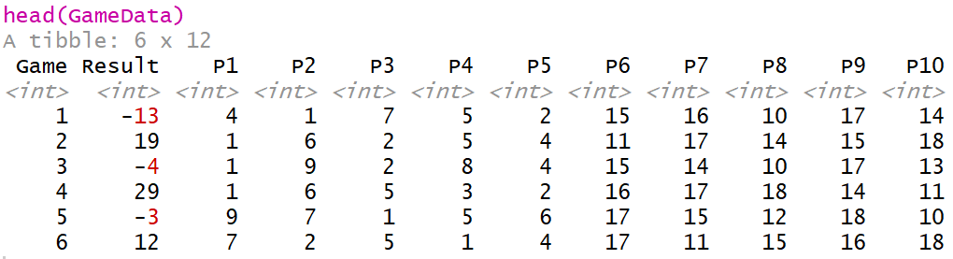
+/- Player Ratings
Adjusted +/- Rating
Adjustment for Teammates Played With
Adjustment for Opponents Played Against
Adjustments Based on Play-by-Play Data Over Whole Season
Average +/- Rating = 0
Simulated Game Data
Players 1-9 Compete Against Players 10-18 in 20 Games
Assume Starters Play the Entire Game
Results of Game Shown Below

Slide 6
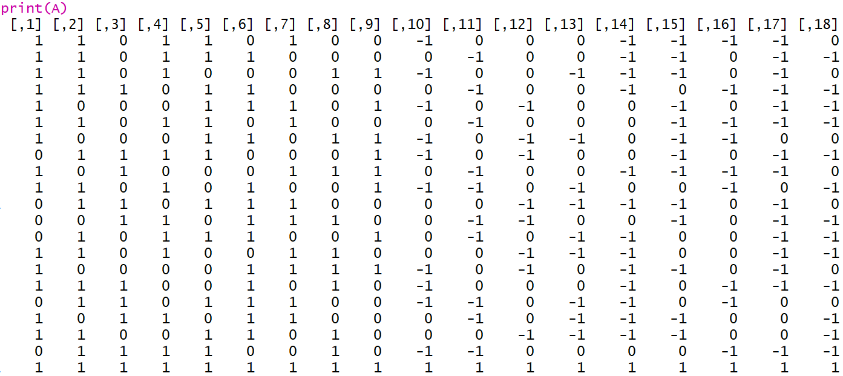
+/- Player Ratings
Modified Game Data into Matrix (A)
Each Row is a Different Game (Except Last Row)
Each Column is A Different Player
1 = Played on Team 1
0 = Did Not Play
-1 = Played on Team 2
Notice Last Row of All 1’s

Slide 7
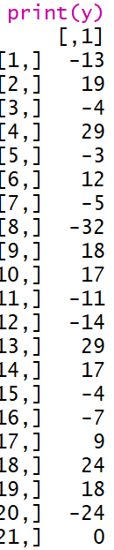
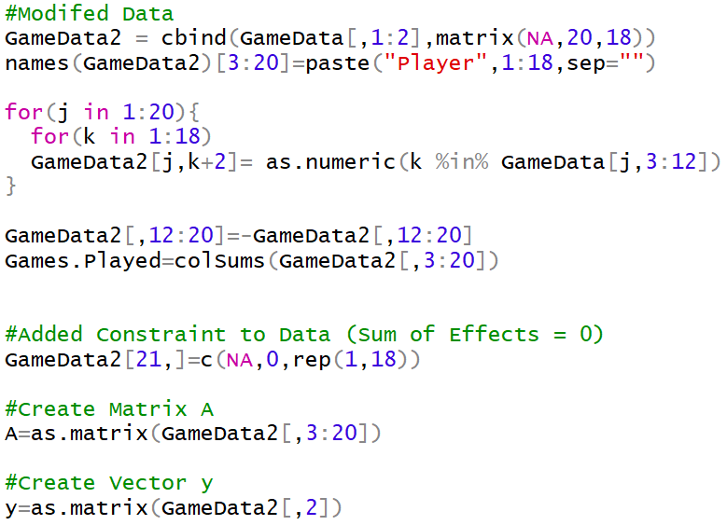
+/- Player Ratings
Game Results into Vector (y)
Each Element is a Different Game (Except Last One)
Notice 0 in Last Element
Code Used to Create Matrix A and Vector y

Slide 8
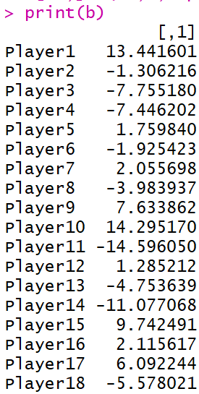




+/- Player Ratings
Goal: Estimate Adjusted +/- for All 18 Players
Expressed into Vector (b)
Constraint: We Want The Sum of Adjusted +/- to Equal 0
We Invoke Constraint With Last Row of A and Element of y
Solve the Linear Equation Using Least Squares Regression
Code for Solving System of Linear Equations
Adjusted +/- For Each Player
$$\overset{⃑}{b}=\left[b_{1},b_{2},⋯,b_{18}\right]′$$
$$\overset{⃑}{y}=A\overset{⃑}{b}+ε$$
$$\overset{⃑}{b}≈{\left(A^{′}A\right)}^{−1}A′\overset{⃑}{y}$$

Slide 9
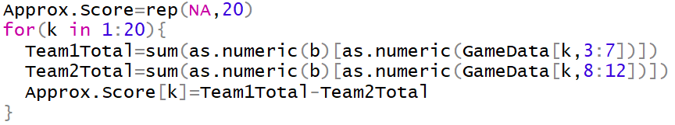

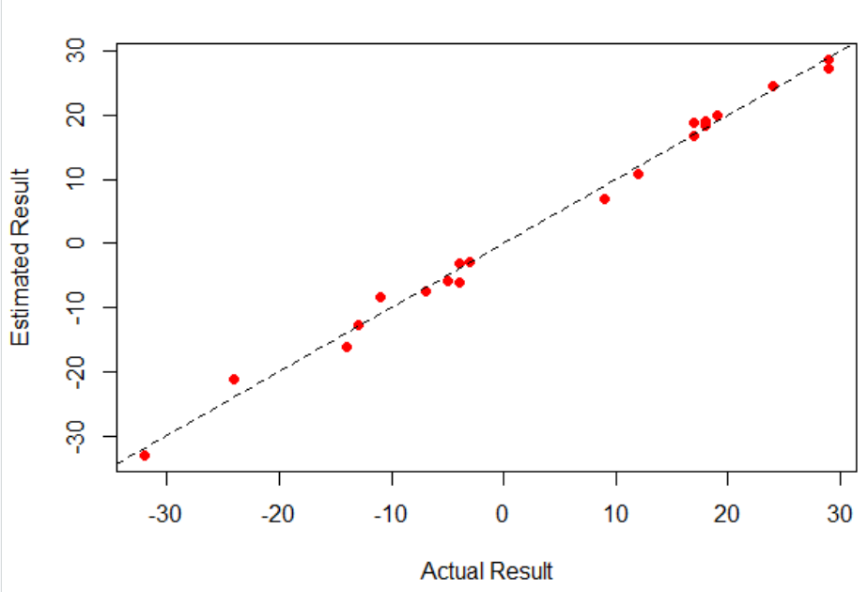
+/- Player Ratings
Can Be Used to Approximate Game Result
Code to Calculate Predicted Scores Using Adjusted +/-
Code and Graphic Comparing Predicted Versus Actual

Slide 10
+/- Player Ratings
Comparing Adjusted +/- to Pure +/-
Let’s Look at Player 15 Who Played 13/20 Games on Team 2
When in Game, Team 1 Averaged 5.4918 Points Above Average
When in Game, Team 2 Averaged 5.1072 Points Above Average
This Leads to a Pure +/- of -0.3846154 Points (Approximately Even)
When in Game and Ignoring Player 15, Team 2 Averaged 4.635 Points Below Average
Ignoring Player 15, the Pure +/- Would Be Horrible …
Adjusting for the Teammates Player 15 Was Playing With, We Would Adjust the +/- by Subtracting Pure +/- With Player 15 Minus Pure +/- Without Player 15 Would Be…
$$\left(−4.635\right)−5.4918=−10.12711$$
$$−0.3846154−\left(10.12711\right)=9.742491$$
Player 15’s Adjusted +/-

Slide 11
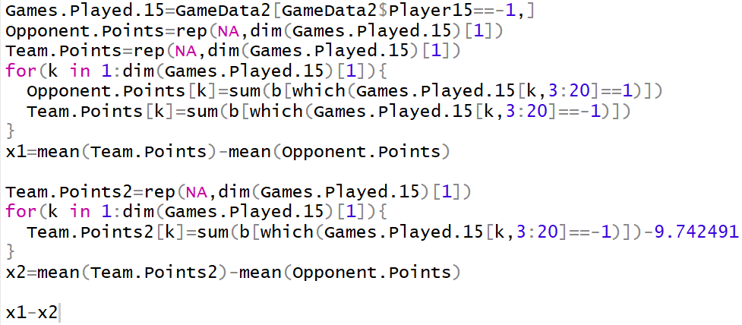
+/- Player Ratings
Comparing Adjusted +/- to Pure +/-
Code for These Calculations on Player 15

Slide 12


+/- Player Ratings
WINVAL System
Created by Wayne Winston and Jeff Sagarin
Adjusts for Home Team Advantage (+3.2 Points Per 48 Minutes)
Adjusts for Time Interval Where Court Composition is Constant
Home Team Scores 9, Away Team Scores 7, and 3 Minute Time Segment
Actual Adjusted Margin is 1.8 Points
Actual Adjusted Margin Per Minute is 1.8/3 = 0.6 Points
$$Adjusted Home Team Score=9−\left(\frac{3}{48}\right)×0.5\left(3.2\right)=8.9$$
$$Adjusted Away Team Score=7+\left(\frac{3}{48}\right)×0.5\left(3.2\right)=7.1$$

Slide 13
+/- Player Ratings
WINVAL System
Predicted Margin Per Minute
Goal: Choose Player Ratings So That the Predicted Margin is as Close as Possible to the Actual Adjusted Margin
Kevin Garnett Had Highest WINVAL of 19 in 2006-2007 Season = He Would Improve His Team by 19 Points Per 48 Minutes
WINVAL can Be Broken Up into Offense and Defense
Kevin Garnett Offense WINVAL of 7 and Defense WINVAL of -12
Using Adjusted +/- to Rate Team
Each Player Has Own Adjusted +/- But Plays Different Minutes
Weighted Average Across Team Can Evaluate Entire Team
$$Predicted =\left[\frac{3.2+Sum\left(Home Player Ratings\right)}{48}×\right]−\left[\frac{Sum(Away Player Ratings)}{48}\right]$$

Slide 14
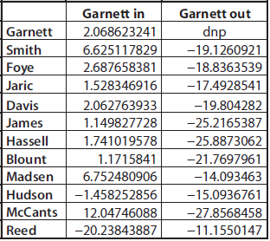
+/- Player Ratings
Further Evaluation of Kevin Garnett’s Greatness
Look at Kevin Garnett’s Impact on Team’s +/- When He is On the Court and On the Bench
Garnett In is Positive
Garnett Out is Negative
Shows Points Better than
Average Team

Slide 15
+/- Player Ratings
Problems With WINVAL
A Lot of Noise (We Can Observe Standard Error in +/- Ratings)
Little Confidence When Player Plays Less Than 500 Minutes
Impact to WINVAL at Meaningless Points of the Game
WINVAL Impact Rating
Similar to SAGWIN Points From Baseball
Constantly Evaluate the Impact a Player Has on Probability of Win
I Play for 5 Minutes and Score is 14-5 Favoring My Team
For the Raw +/-, I Would Net +9 Points
Alternatively, I Increased My Team’s Chance of Winning from 50% to 72%
For Impact +/-, I Would Net +22 Impact Points
Interpretation: Kevin Garnett (Impact = 42) with 4 Average Dudes Would Beat 5 Average Dudes 50%+42%=92% of the Time

Slide 16

+/- Player Ratings
Improvements to Adjusted +/-
Research by Joseph Hill (2010 Winner of Sloan Paper Competition)
Applies Cross-Validation = Intentionally Splitting Up Data to Use Portions As Training and Test Sets and Then Averaging Over Splits
Applies Ridge Regression = Combat Overfitting and Shrinks Player’s Adjusted +/- Toward 0
Cross-Validation Necessary for Selection of Tuning Parameter in Ridge
Applies Weights to Loss Function Based on Number of Possessions

Slide 17

Final Inspiration
Nine out of 10 schools are cheating.
The other one is in last place.
- Jerry Tarkanian

